Slide 1
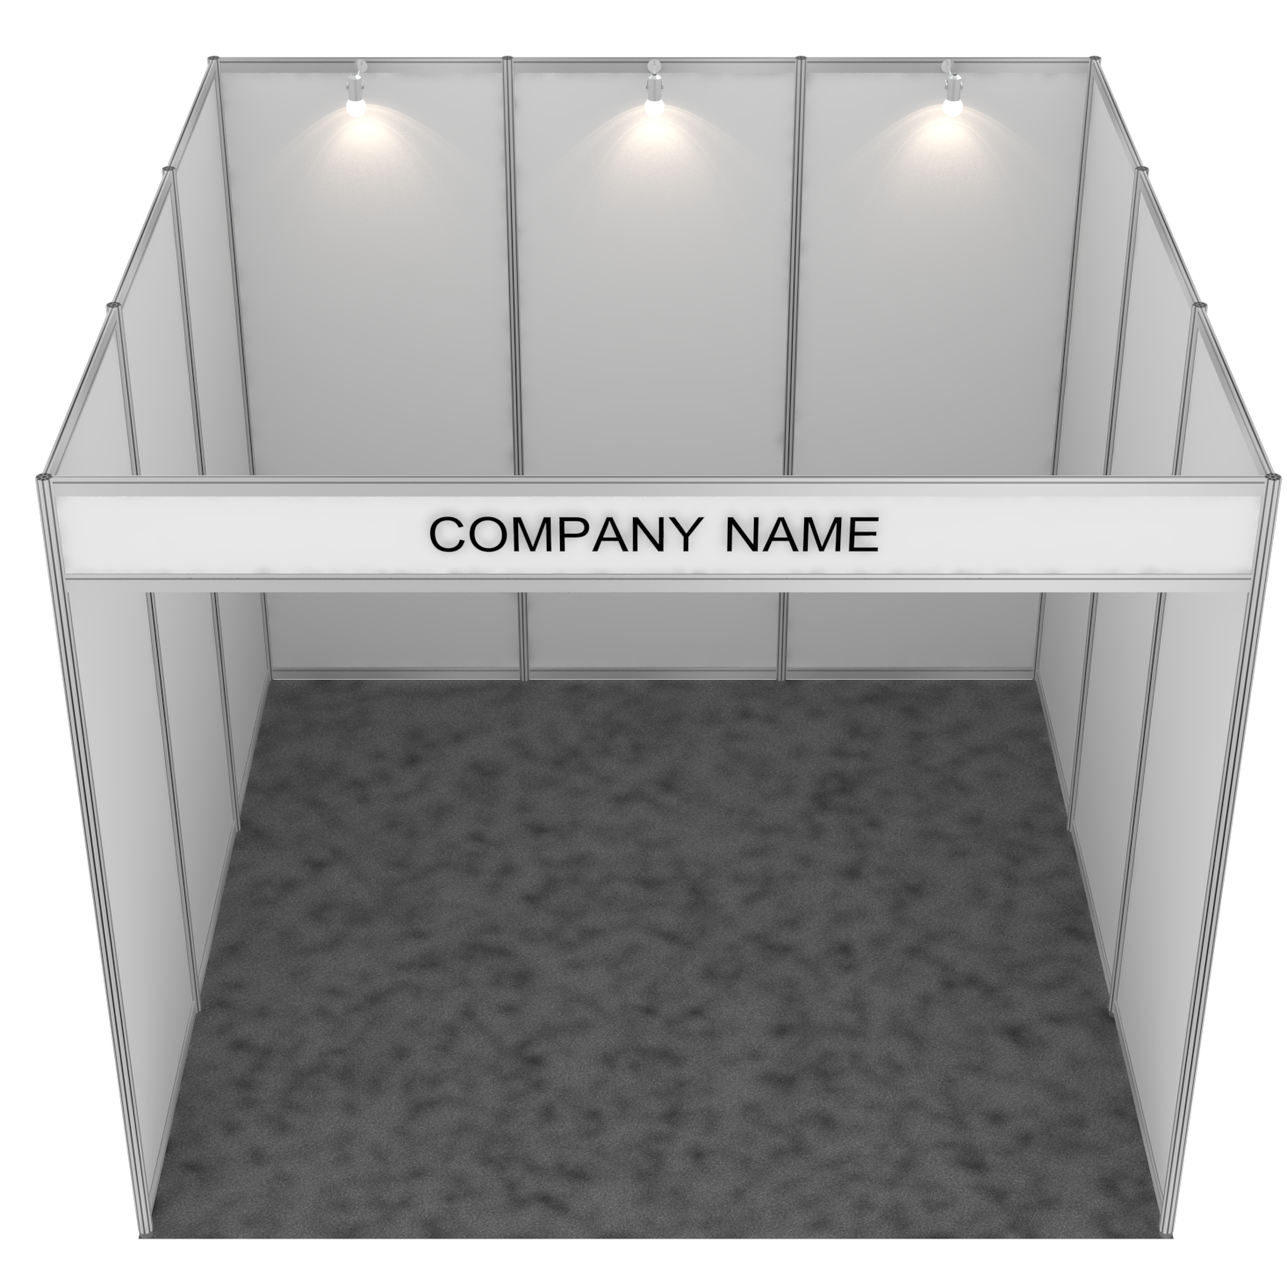
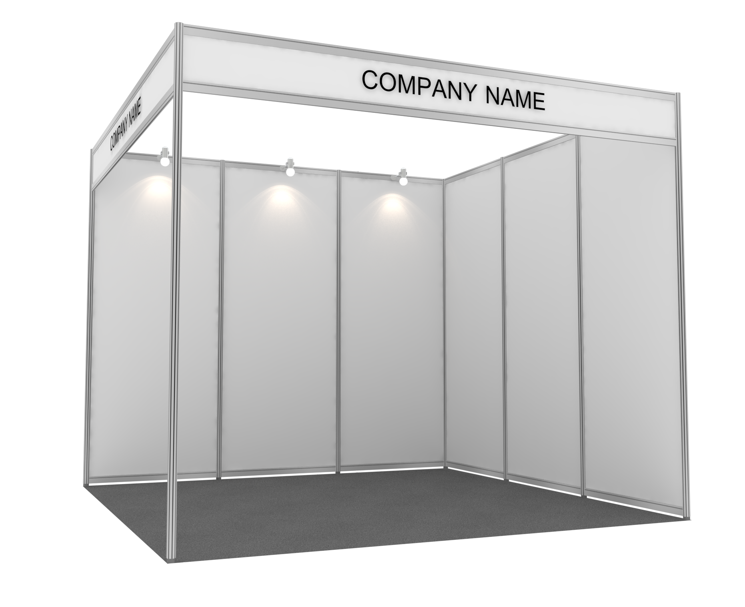
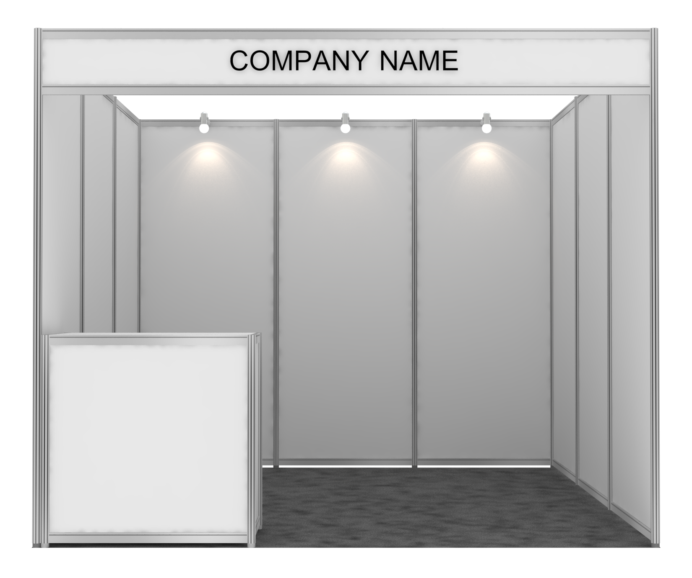
Booth Branding Guide
3
7
2
8
4
5
6
Left side - inside booth
Front side - inside booth
Right side - inside booth
1
9
1
2
3
4
5
6
7
8
9
· Branded panel quantity(1 side open type) : 9 panels(Panel NO. 1-9)
· Branded panel quantity(2 side open / corner booth type) : 6 panels
· Art work size of panel : W970 × H2390mmH
· Front size of reception counter(Optional item / Furniture number #FS-002) : W945 × H610mmH
Shell scheme booth perspective(3m x 3m)
Shell scheme booth-6 panels
(Corner booth type)
Art work size :
W945 × H610mmH
- After checking the location of the booth you selected, please specify the wall number you want to brand.
- For individual panel graphics, please create a files so that it does not exceed the graphics workable size (W970 × H2390mmH) for each panel.
- If you don’t have whole panel graphic, please also indicate the location of the graphic-(example) 20cm below the top of panel number1
- Printing files format: AI file(Adobe illustrator), EPS, JPG(High resolution) only

